Slide 1
Refinery Scheduling

Slide 2

Org Chart
Section
Head
Production Planner
Product Scheduler
Blending Analysts (3)
Light
Distillates
Middle
Distillates
Black
Products

Slide 3
INTERACTION
Marketers and Traders
Domestic – PDB
Export - LPPG
Internal interaction:
PLN : Refinery Planners
Ops : Superintendant
Ops : Process Areas
Ops : Oil Movement
Ops : Marine
Process Engineering
Laboratory
Supply Chain Schedulers MPSG
Refinery
Operators:
Pipeline (PSP, KAFS)
TTLR (PDB, Ops)
Ocean/Coastal Berths (Agents, Surveyors)

Slide 4

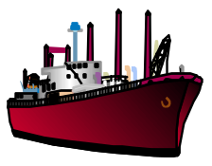

OVERALL SCOPE
PROD NOMINATION
FEEDSTOCK NOMINATION
PROD EVALUATION
FEEDSTOCK EVALUATION
PROD FORECAST
FEEDSTOCK FORECAST
PRODUCT BLENDING
PROCESS UNIT
PROD SCHEDULE
FEEDSTOCK SCHEDULE
PETRONAS (MPSG)
CONOCO
CRUDE/ INTERMEDIATE/ FEEDSTOCK TANKAGES
FINISH PRODUCT/ SHIPPING TANKAGE
COMPONENT/ BLENDSTOCK TANKAGE
PETRONAS (PDB, LPPG)
CONOCO

Slide 5
Function
Production Planner
Communicate via daily operating plan based on weekly unit regulation.
Optimise blend component yield and quality.
Track production variance against plan.
Optimise use of facilities

Slide 6
Production Planner
Function
Ownership:
Planning
Scheduling
Asset Owners
RSM
Unit
Regulations
Plant Moves
Daily
Instructions
Variance
Upset & Constraints

Slide 7
Product
Scheduler
Function
Develop monthly product program.
Coordinate lifting plan for MPP, TTLR and Coastal/Ocean Berths.
Track product lifting performance (Plan vs. Actual)
Track product optimisation performance via indicators (BUST, PQGA, Demurrage, PQM Release Margins)

Slide 8
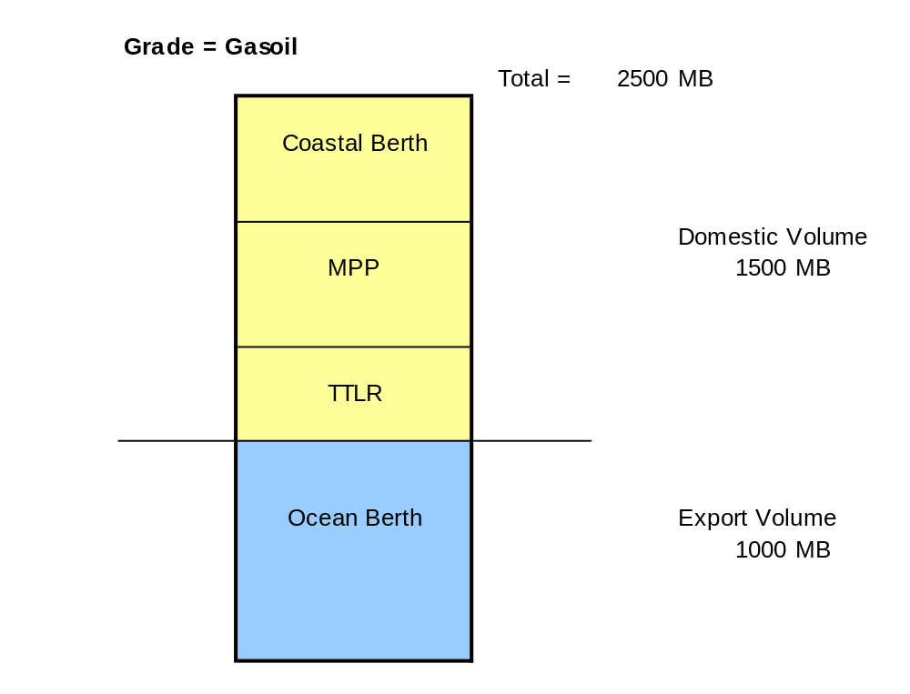
Product
Scheduler
Modes of lifting

Slide 9
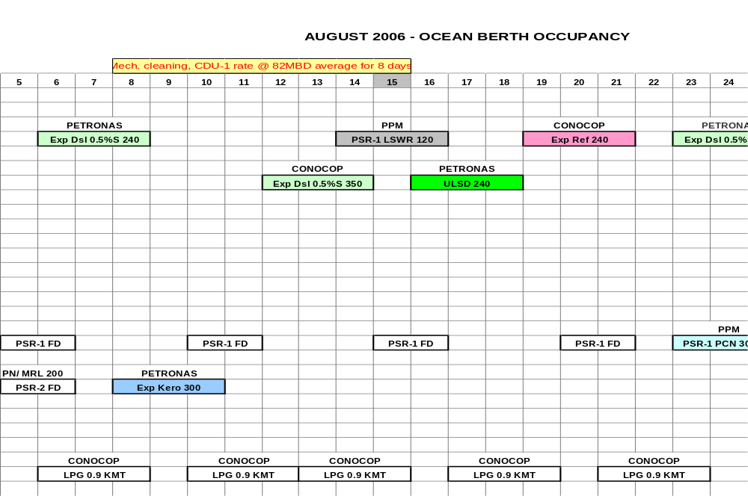
Product
Scheduler
Sample of Berth Schedule

Slide 10
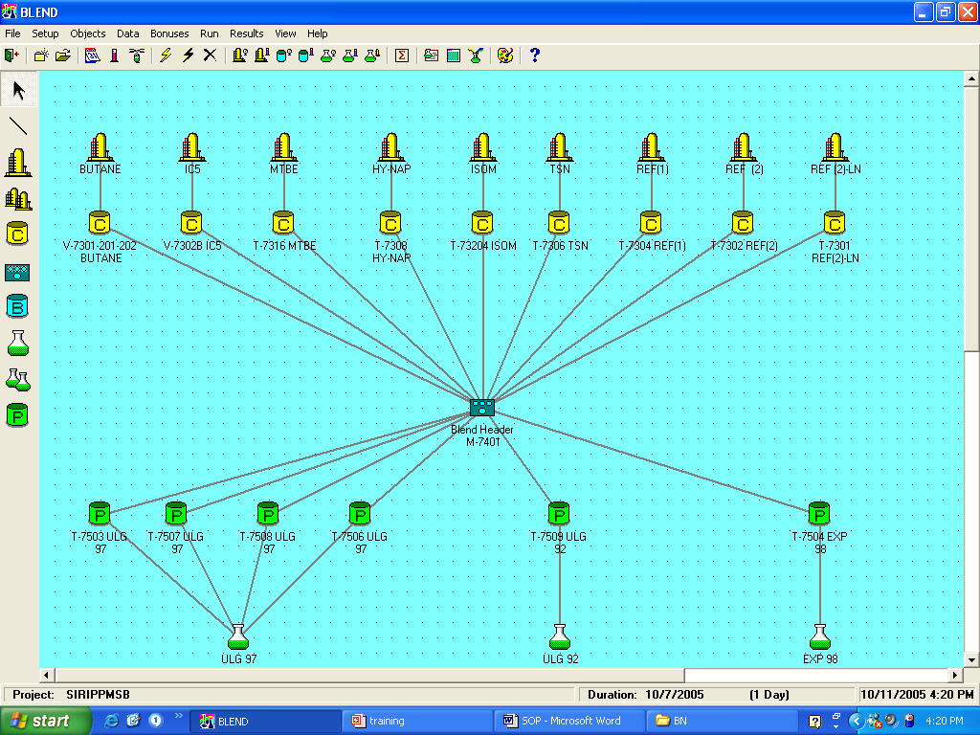
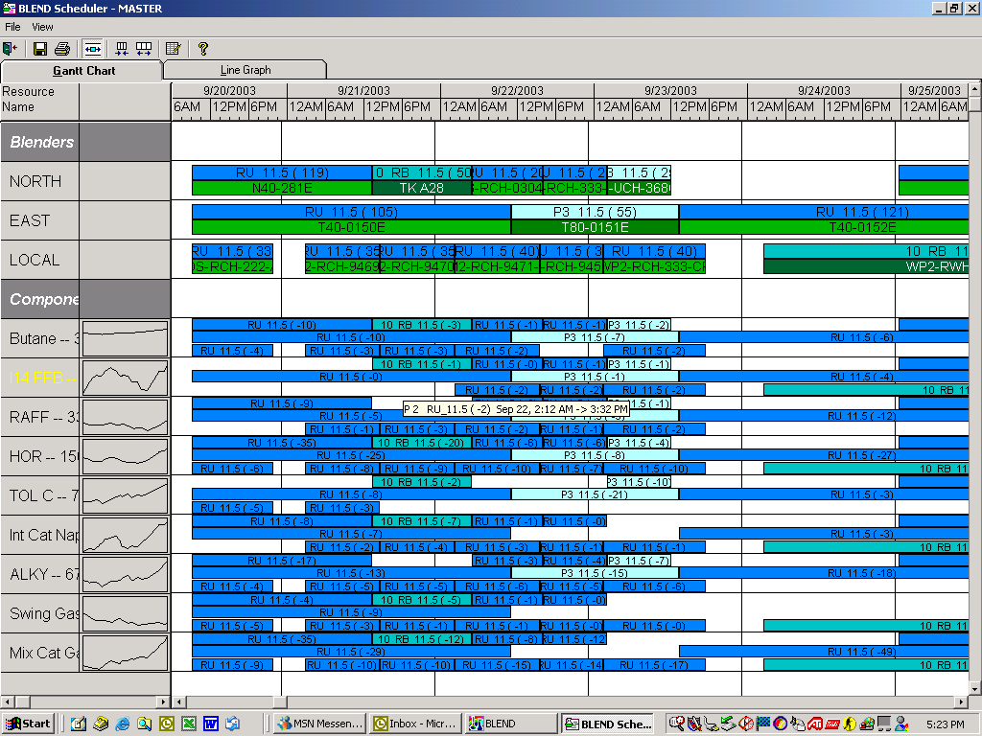
Product
Scheduler
Sample of Tools

Slide 11
Product
Scheduler
PQGA
Reblend
for Correction
Reblend for
Quality Giveaway
Reduction
Release Product
Specification
Blend
Target
Max Allowable Giveaway

Slide 12
Blending Analyst
(Light Distillates) Function
Product blending
    4 Gasoline grades plus PCN.
    Tank management to ensure optimum stock level at all times (BUST).
    Minimise product quality giveaway.
    Minimise demurrage cost.
    Upgrade lower octane material (Light Naphtha, Isopentane, Butane)

Slide 13
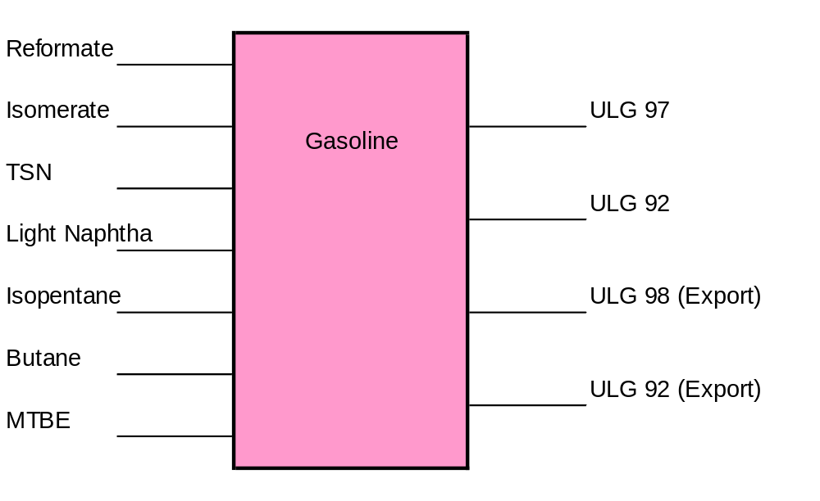
Blending Analyst
Light Distillates : Components/Products

Slide 14
Blending Analyst
(Middle Distillates) Function
Product blending
    Diesel and Kerosene grades.
    Tank management to ensure optimum stock level at all times (BUST).
    Minimise product quality giveaway.
    Minimise demurrage cost.
    Upgrade lower value material (AGO, Heavy Naphtha)

Slide 15
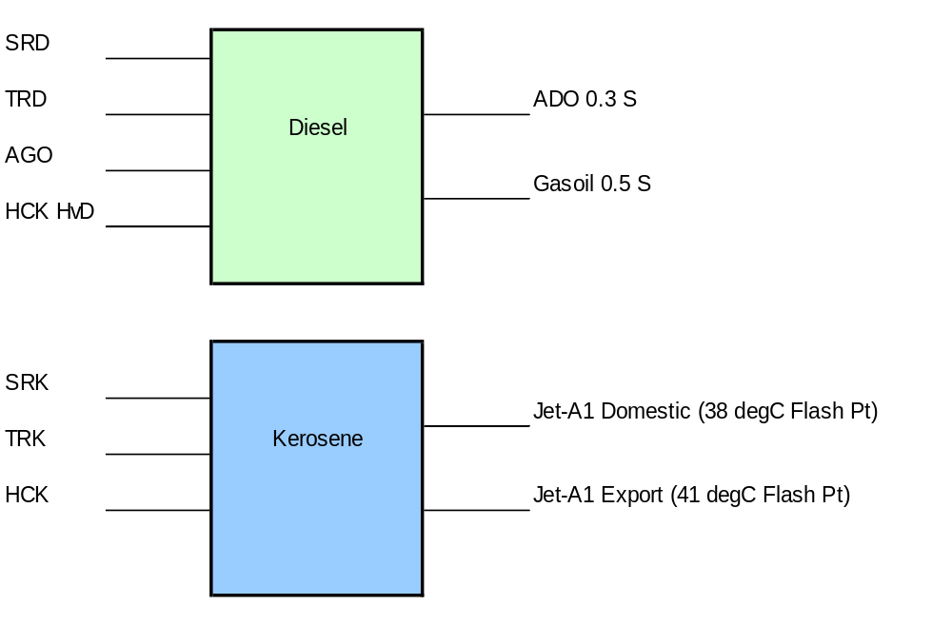
Blending Analyst
Middle Distillates : Components/Products

Slide 16
Blending Analyst
(Black Products) Function
Blend Fuel Oil and Bitumen grades.
Manage Coke, Sulfur lifting.
    Tank management to ensure optimum stock level at all times (BUST).
    Minimise product quality giveaway.
    Minimise demurrage cost.

Slide 17
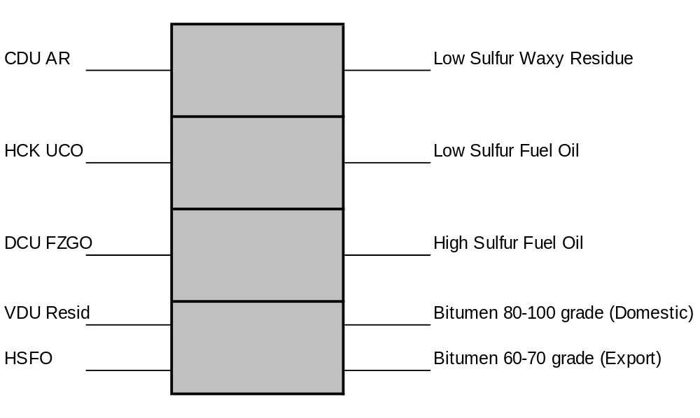
Blending Analyst
Black Products : Components/Products

Slide 18


Upgrade lower value components
BUST
Improve blending margin
Demurrage
Unplanned grades & volumes
PQGA

Slide 19


Operational issues
(sampling delays, lab data quality, loading delays)
Component
shortages
Vessel delays
New specs
LSWR
VR
C4
Hardware constraints
(tanks, pumps, inline blenders, ocean berth)

